Slide 1
Self-supervised Learning via Conditional Motion Propagation
Xiaohang Zhan, Xingang Pan, Ziwei Liu, Dahua Lin, Chen Change Loy
CVPR 2019

Slide 2
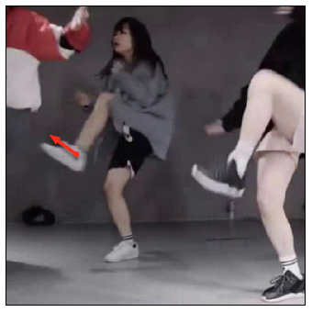
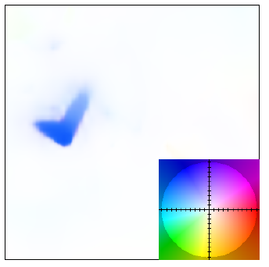
How human imagine motion from an image?
Abstract instructions
e.g.: The object (human) raises this part (leg).
Kinematic properties of objects
Image
Scene motions
An articulated object.
Rigid parts.

Slide 3
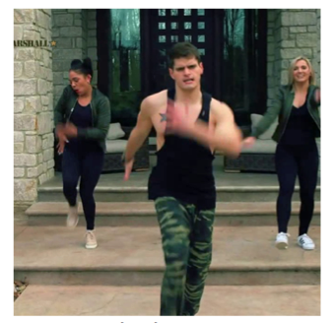
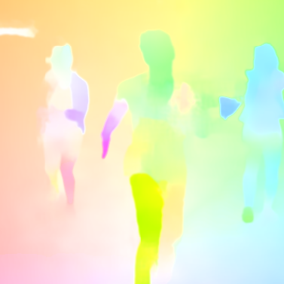
How human imagine motion from an image?
Abstract instructions
Sampling from optical flow
Kinematic properties of objects
Image
Scene motions

Slide 4
Framework
Abstract
instructions
Expected to learn
kinematic properties.

Slide 5
Sparse Motion Sampling

Slide 6
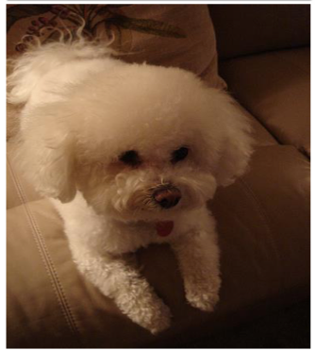
Representation Learning Evaluation
Pretext task
backbone
Semantic segmentation
Object detection
Instance segmentation
Human parsing
Target task

Slide 7
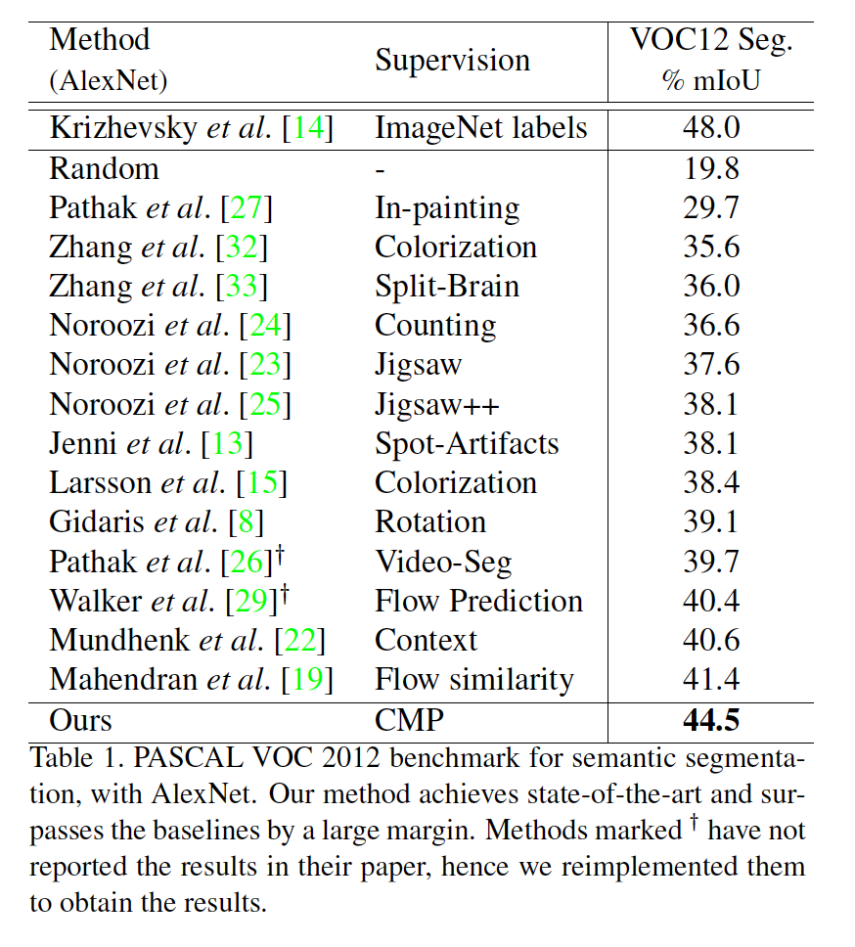
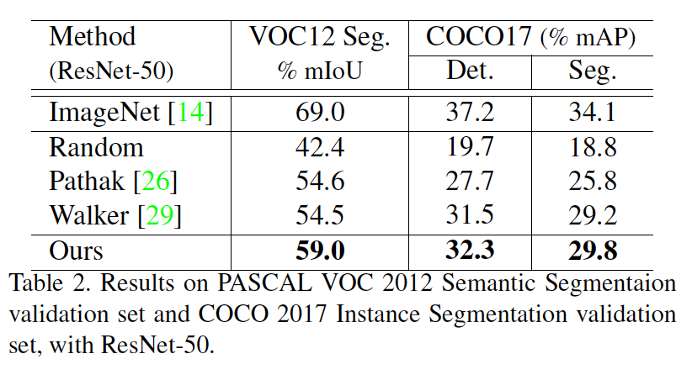
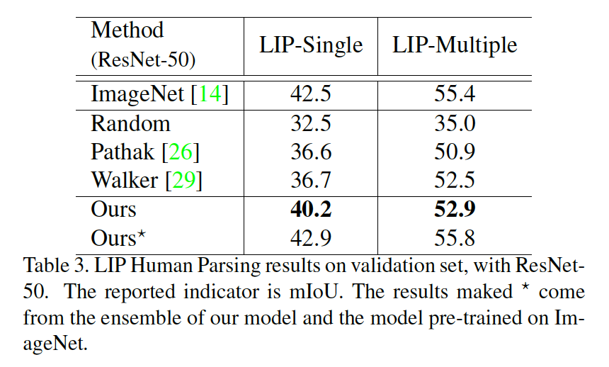
Representation Learning Evaluation

Slide 8
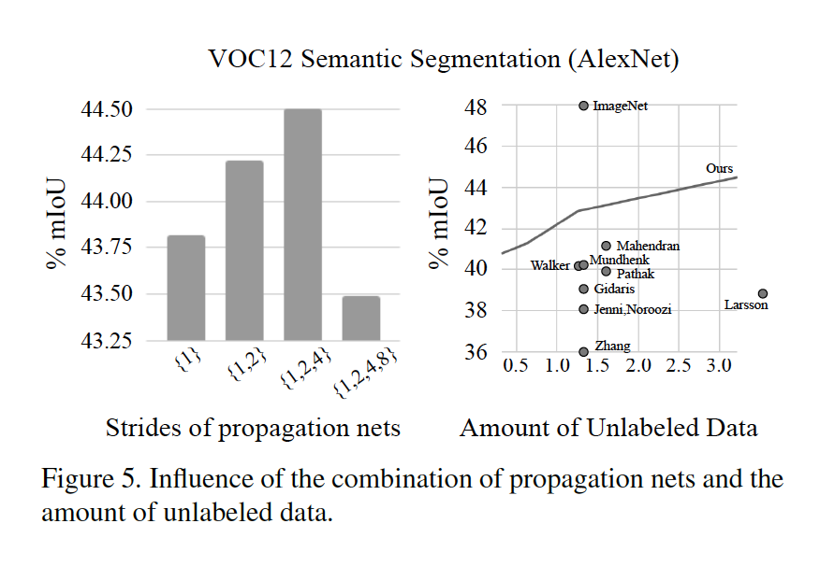
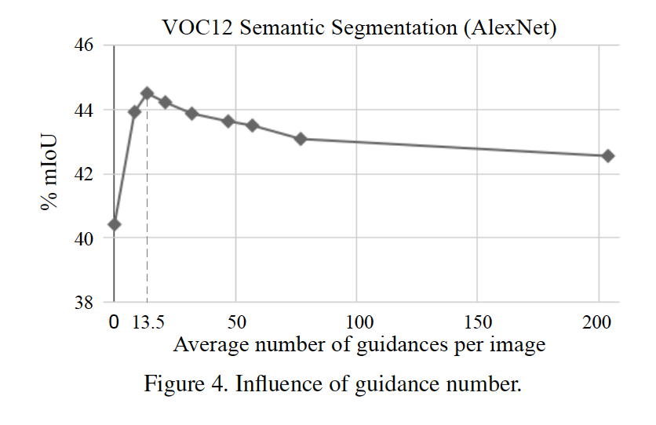
Representation Learning Analysis

Slide 9
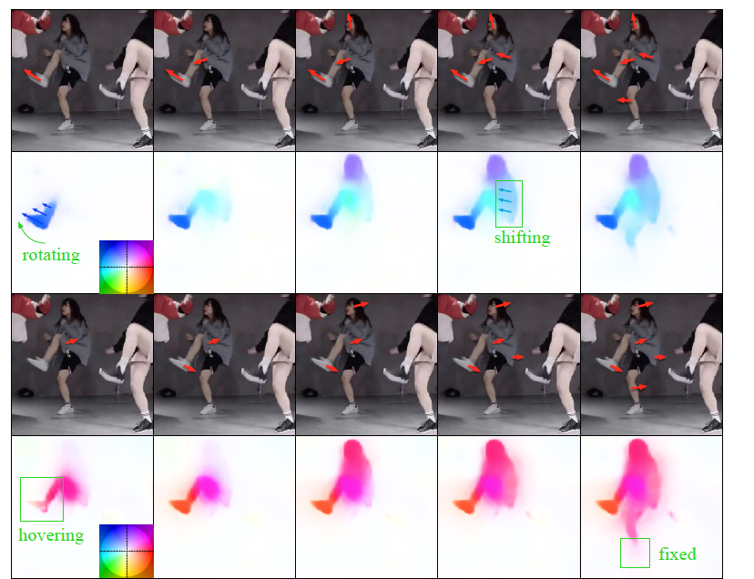
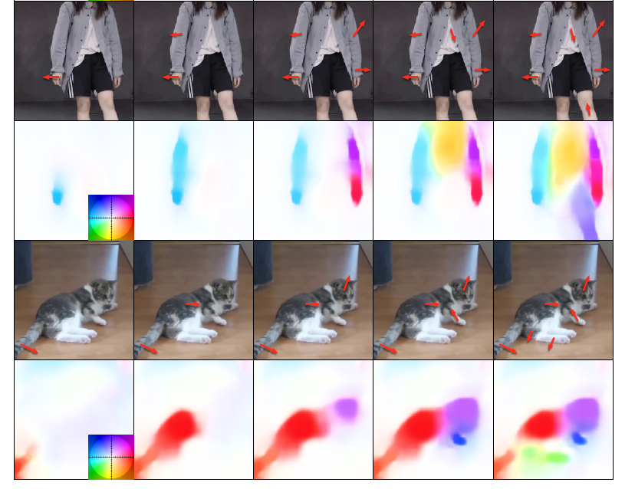
CMP Testing
In testing, the guidance can be arbitrary.

Slide 10
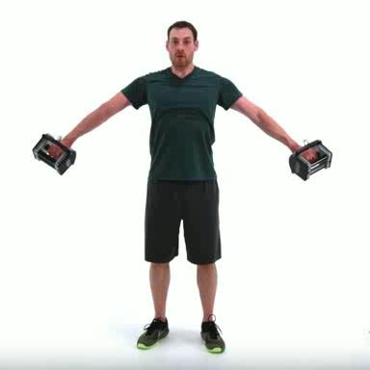
Applications
Guided Video Generation:
guidance
image
flow
warping
next frame
CMP
inference

Slide 11
Applications
Semi-automatic Instance Annotation:

Slide 12
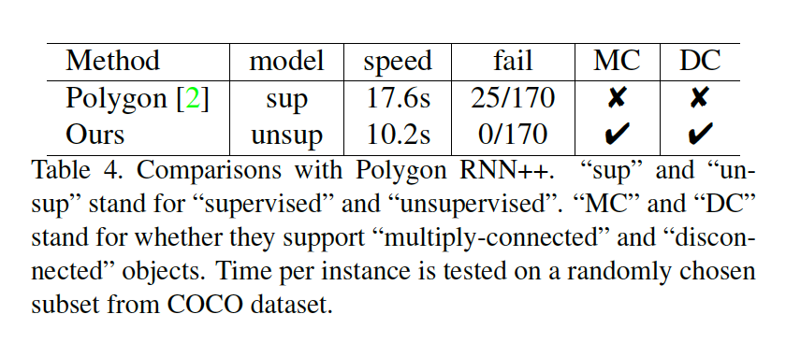
Applications

Slide 13

Applications

